Slide 1
Knowledge Graph based DaaS T CED INW-CN | YU He
Restricted @ Siemens AG 2022
Siemens.com

Slide 2



Outline
Background and Business Scenarios
Use-Cases and Technical Solution
Summary and Q&A

Slide 3
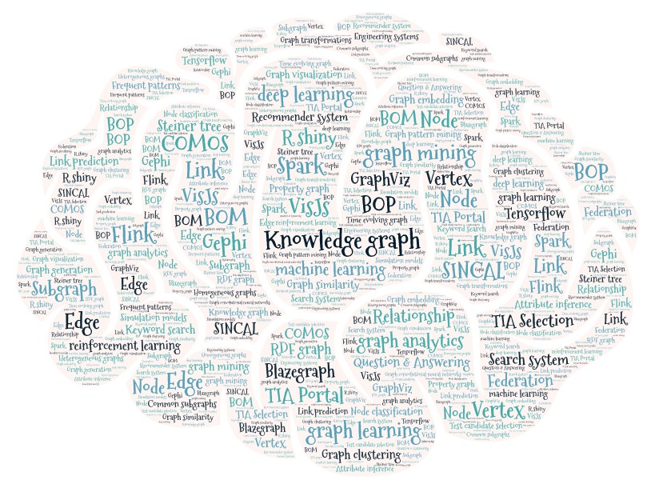
What are knowledge Graphs?
Knowledge Graph are semantic descriptions of entities and their relationships. It uses a knowledge representation formalism, for example: RDF, RDF Schema and OWL.
Main components of any semantic graph are:
Entities: Real-world objects (things, place, people) and abstract concepts (process, process, performance)
Relationships: Graph-based data model, where relationships are first-rate
Semantic descriptions: Types and properties with a well-defined meaning (e.g. including, cause, have through an ontology)

Slide 4
Why knowledge Graphs?
Knowledge Graph is the only technology that provides a structured and formal representation of knowledge. It enables to capture domain knowledge that is usually surrounded by entities, which are connected by relations.
Benefits:
Organization and solidification of knowledge
- Central knowledge repository to represent, simplify and connect the knowledge about relevant entities in the enterprise.
- Unified structure, data model and semantics.
Enrichment and contextualization of knowledge
- Concrete the intangible knowledge and experience into enterprise capital.
- Bridging enterprise knowledge, incl internal and external domain knowledge.
Collaboration and sharing the knowledge
- Cross-organizational data analysis become possible.
- Individual are empowered to share knowledge and make decisions based on comprehensive knowledge.
- Simplified publish and sharing of data leads to improved communication, increasing knowledge sharing and reduced redundancy of work.

Slide 5
Where we see Knowledge Graph? The business scenarios of industry
Scenario Category | Knowledge Source | Application Function
Quality Control | Manufacturing process variables and their correlation (Such as quality parameters, equipment parameters, process parameters, environmental variables, etc.) and quality exception cases. | According to the phenomena and characteristics of quality problems, match the related problem causes and corresponding solutions as reference. The entity relationship network of the quality influencing factors is used as the input of the parameter optimization algorithm or the quality prediction model to timely adjust the process parameters according to the results.
Device Operation and Maintenance | Device operations manual, standard production parameters of devices, fault cases, maintenance record and report, etc. | According to the fault events or phenomena, match the related fault causes and corresponding solutions for reference. The entity relationship network of fault events is used as the input of the algorithm to realize fault diagnosis.
Workshop Planning and Scheduling | Production planning elements (including orders, raw materials, production equipment, in plant logistics and other information) and historical planning scheme | Query similar planning and scheduling schemes for reference according to order requirements or production task characteristics. Take the entity relationship network of order information or resource information as the input of the optimization solution model, and then generate specific optimization schemes in terms of task allocation, resource allocation, path planning.
Product Design and Development | Product design elements (including product type, product structure, geometric features, processing parameters, design constraints, etc.) and historical design scheme | Retrieve similar design instances to obtain reusable or referential design data, rules and models. Infer the implicit information (constraint information, dimension information, design history) in the product design model to facilitate the secondary utilization and optimization of the design model
Data integration of manufacturing system | Enterprise information system database (ERP, PLM, MES) and intelligent manufacturing standard (OPC UA, AutomationML, etc.) | Provide information tracing of the whole life cycle of products, and provide data quickly according to requirements during the manufacturing process. Semantic integration of manufacturing resources to realize the interconnection of manufacturing equipment and unified data processing.

Slide 6
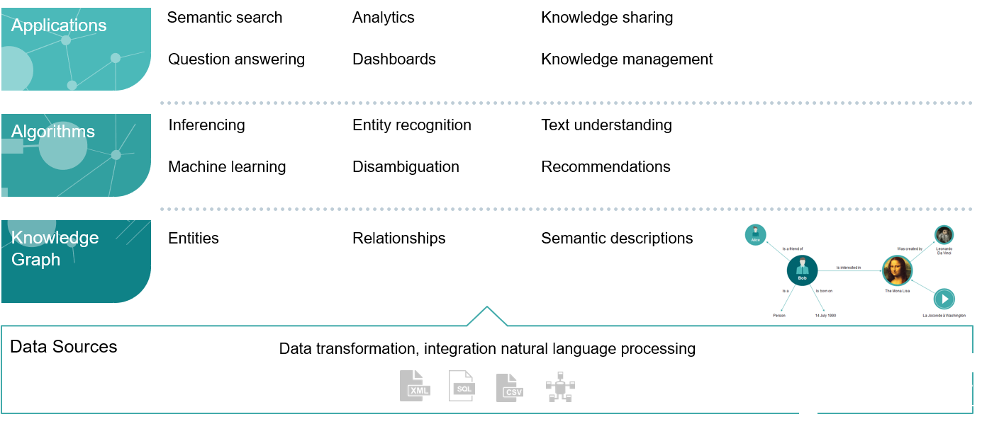
Knowledge Graph as glue layer

Slide 7

How to understand the dimension level of the scenarios?
Application
Comprehensive decision
Qualitative decision
Semantic extraction and organization
Manufacturing staff and Engineers
Manufacturing System
Manufacturing Supply Chain
Top-down construction, no update
Scenarios
Passive update
Self learning and self-organization
Bottom-up construction
Technology

Slide 8








Technical space in general knowledge graph service
Single & Multiple Graphs
Subgraphs
Links
Nodes
Classification
Clustering
Generation (hard and soft constraints)
Similarity / Matching
Frequent subgraph mining
Anomalous subgraph patterns
Classification
Clustering
Link prediction (latent / missing links, future links)
Classification
Clustering
Classification
Attribution inference
Similarity
Clustering
Anomaly detection
Learning
Technologies
Graph Pattern Mining
Tensor
Factorization
Graph Convolutional
Neural Networks
Knowledge Storage
and Representations
RDF
Graph
Property
Graph
Simple
Graph
Time Evolving
Graph

Slide 9
Which points can be our advantages and highlights?
Integrated Foundation
Materials
Contextualized Template
Ecosystem
Efficient
Domain Know-how
Machine experience
Data Access
Up-to date
Easy to use
Commissioning

Slide 10

Which points can be our advantages and highlights?
Knowledge
Source Up-to-down domain know-how
Standard data structure
Automation
Data Down-to-up smart data structure
Signal and event processing
Iteration
Feedback Experienced engineers validation
Knowledge repository management
Device design & performance parameters
On-site device control logic or parameters
ISO 15926 standard
Maintenance record and experience
……
On-site hierarchy data structure or SiPlant data structure configuration
Event or error-code signal description and process logic
Knowledge and data correlation or label
……
Experience engineers validate and feedback to the knowledge graph
Buildup knowledge repository based on device and line or workshop
…..
Pre-defined ontology
Typical semantic template
Enrich update capability
Easy match real-time data and association reference
Domain knowledge repository
Iteration based on on-site feedback (people, OT and machine)

Slide 11
Outline
Background and Business Scenarios
Use-Cases and Technical Solution
Summary and Q&A

Slide 12

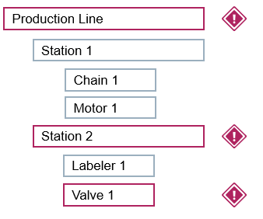
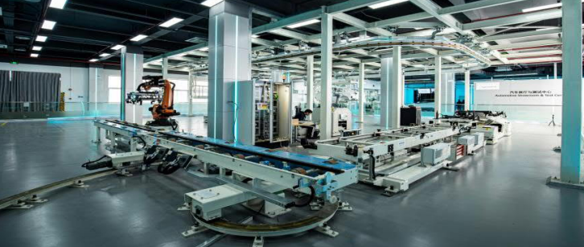
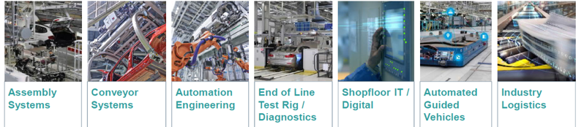
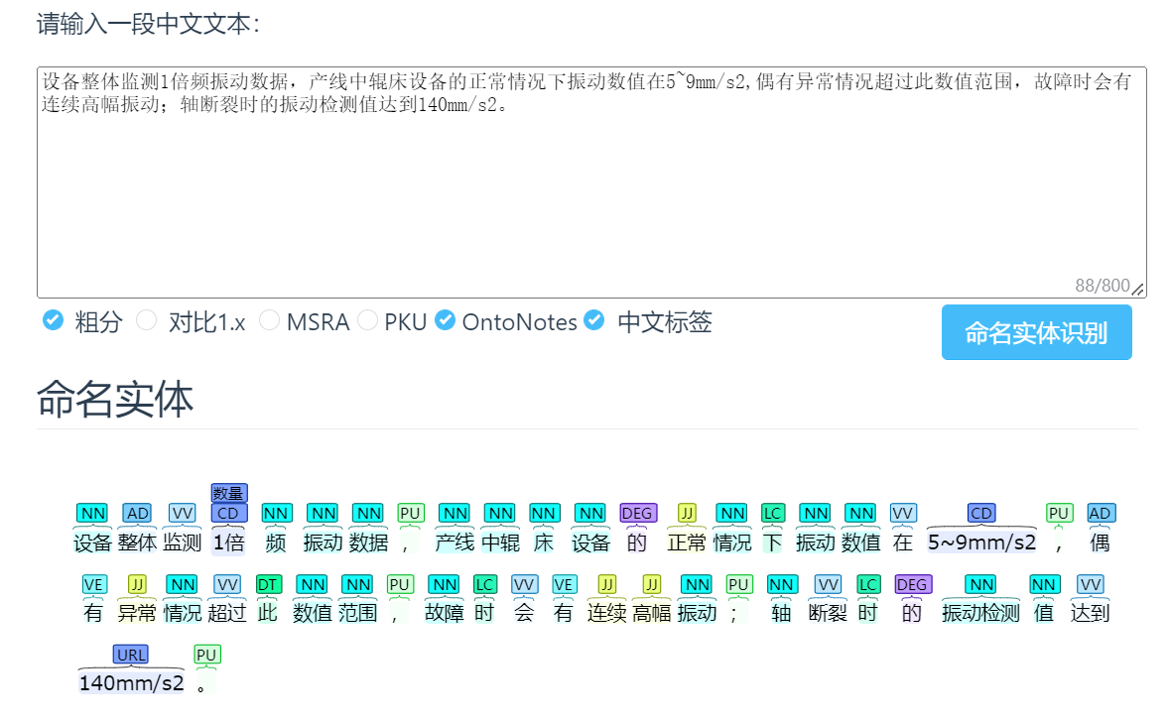
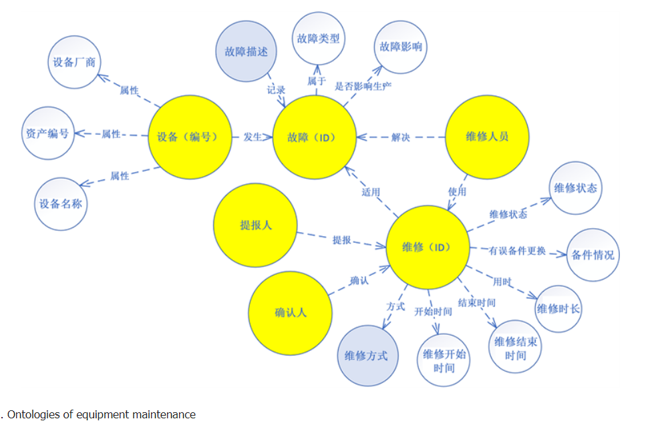


Addressable customer business scenarios for V1.0 Focus is on Pre-maintenance and DaaS with advanced KG
KG Modeling Tool
Engineers and experts to setup the common domain model based on modeling tool.
Knowledge based DaaS
Integrate domain knowledge and on-site real-time data to realize collaborative analysis and prediction.
Knowledge Repository
Manage knowledge models and provide the standard library services to end-customer.
TIAPortal
SiPlant
SiMove
…
Repository
Knowledge
Graph DB
Automation
Data
Abnormal Detection (DaaS)
Pre-defined ontology
Typical semantic template
Standard device knowledge
Diagnosis with iteration ability
Enrich update capability
Analyze real-time data and association reference

Slide 13
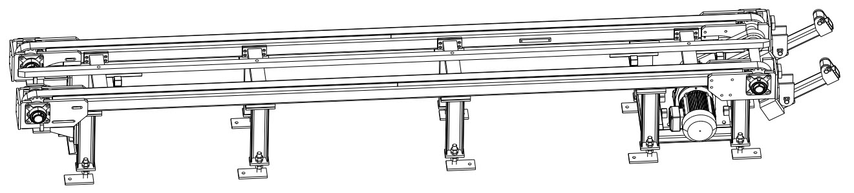





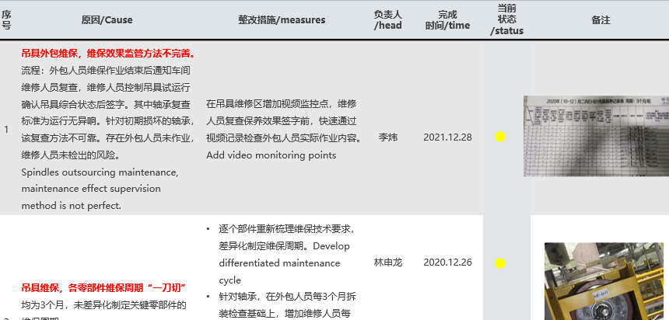
UseCase1- Modeling tool for pre-maintenance KG generation
Engineering Specification
Modeling Tool
Graphical
Representation
Script (SPARQL) import pattern forms maintenance knowledge ontology
Support ontology edit by UX
Components and Design parameters
Semantic extraction by defined rules or templates (e.g. XXX故障/异常/宕机/断电…导致/致使/损坏/表征….XXX)
Extraction training by AI algorithms (Irregular input)
Text Description
Script to trigger and event of entities
Represent the graphic knowledge by GraphDB client
Support trigger and event edit by UX
Develop customized front for semantic retrieval and other UX operations.
Maintenance Report
First step, based on Semantic (CN) library
Second step, focus on front-end UX operation and application requirements

Slide 14
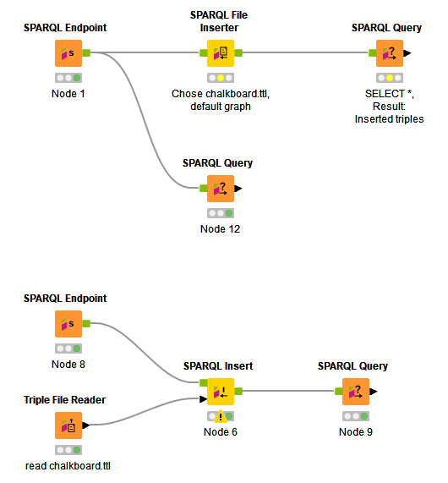
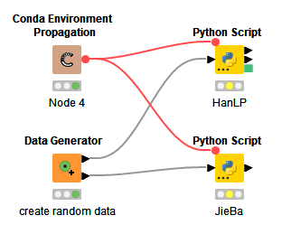

UseCase1- Modeling tool for pre-maintenance KG generation Work scope
Step1 Proof of concept for semantic extraction and KG storage technology
Build basic maintenance ontology and form SPARQL script templates.
Semantic extraction modules (realized and validated by KNIME) :
Chinese-Semantic extraction library (Jieba, HanLP)
Rules definition and extraction templates
Maintenance report import and info capture
Knowledge label module
GraphDB rdf storage module
Present knowledge graph by GraphDB client, support knowledge retrieval
Step2 Provide KG modeling tool to engineering
Based on step1 modules to develop Python web-application
AntV G6/X6 front-end buildup to support UX operations:
Support on-site engineers to edit or extend knowledge
Knowledge retrieval and representation, incl knowledge nodes (entities) , prosperities and relationship descriptions
Event and trigger reminder, edit and update.
Supplementary configuration of knowledge integration by drag-and-drop.

Slide 15
UseCase2- Knowledge based Device as a Service
DaaS-MaintLoop
Algorithms Layer
Alarm Mgmt
Data
Collection
SVM
GBRT
Neural network
Sample Mgmt
DaaS-
MaintLoop
Reports
Threshold-SPC
K-Means
Linear Regression Forecasting
Decision Tree
Schema Configuration*
链床异常
Automation Monitoring
FEMA
Modeling Tool
Domain Knowledge
Site Setup
Automation Error Code
Problem
Statement
输送链床轴断裂，1倍频振动强烈，数值达到140mm/s2；正常状态值在10~15mm/s2之间。
输送链床的电流和速度表征相似，强相关。链床异常时，托盘到达时电流值有异常高值，且具有周期性。
PA08工位的异常会影响PA09和PA10工位振动。
DaaS-MaintLoop Schema*: The core module for site configuration, samples and matching the selected algorithms

Slide 16

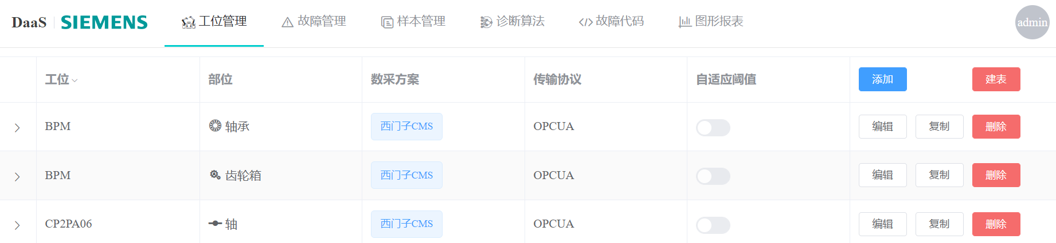
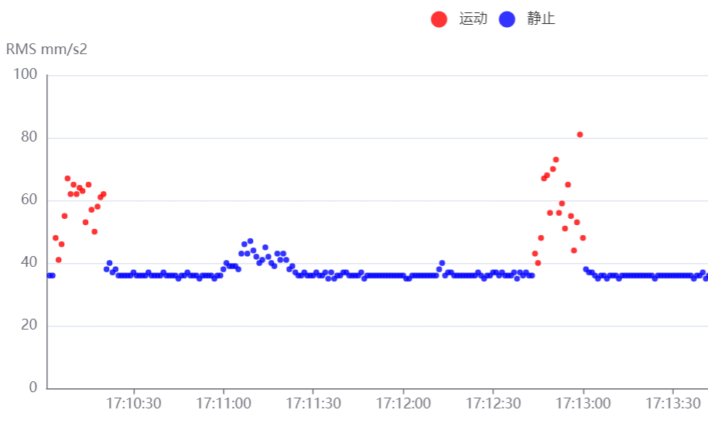
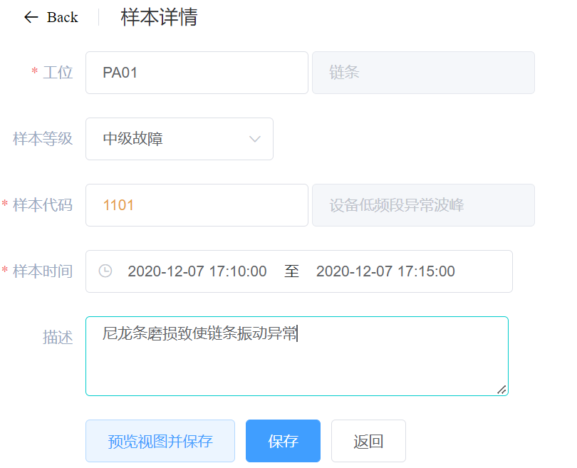
UseCase2- Knowledge based Device as a Service Work scope
Step1 Proof of concept to config algorithms selection and parameters definition
Rebuild DaaS-MaintLoop schema configuration, add context broker and context analysis modules to support knowledge extraction.
Select algorithms and configure parameters based on knowledge:
Friendly design to show which station have pre-experience and knowledge and support presentation.
Arrange algorithms to stations (provide the score based on MaintLoop history samples data).
Support automatic matching and manually definition for the knowledge value or parameters to algorithms.
Logs for knowledge based algorithm score.
Step2 Proof of concept to enrich knowledge graph by Sample Label and feedback.
Make up for the lack of prior knowledge, MaintLoop-Sample Management can help user to check the on-site abnormal and data features to accumulate know-how.
Enrich the knowledge graph by sample label and feedback comments:
Extract context info of labels and feedback comments as entities to integration with Modeling Tool.
Capture data features or calculate statistics features for maintenance knowledge.
Enhance the correlation relationship based on the feedback and data. (e.g. “此次故障由尼龙条磨损引起，致使链条振动异常”)

Slide 17
Outline
Background and Business Scenarios
Use-Cases and Technical Solution
Summary and Q&A

Slide 18
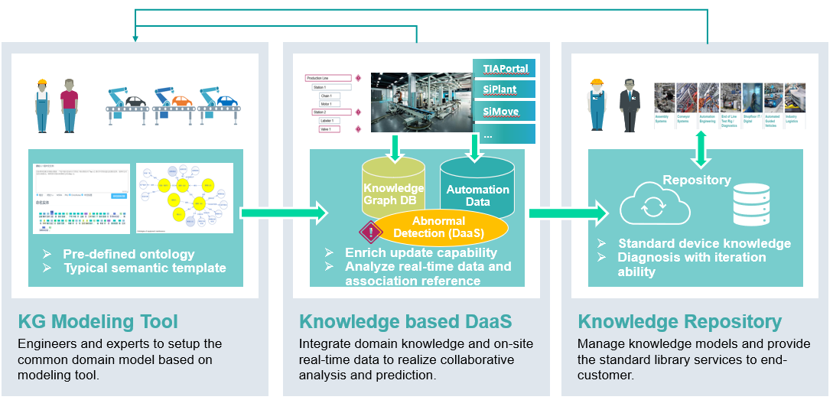
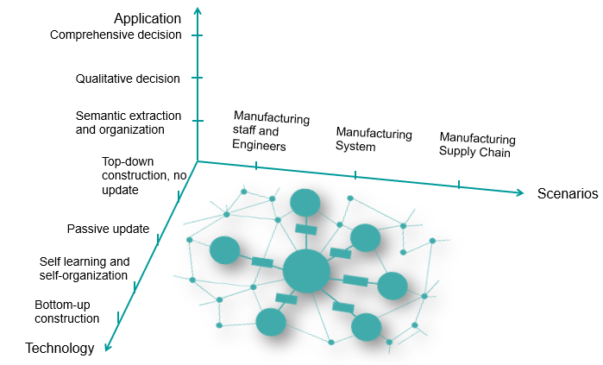
Summary
Aggregate industry knowledge and make it editable and visualized.
Combined with existing DaaS, enhanced knowledge-based configuration, monitoring and predictive analysis.
Current status focus on manufacturing staff and engineer scenario. In the future, with the verification of the knowledge models, build the knowledge repository by MLOps.

Slide 19



Risk
Knowledge is expensive~ it’s much more expensive than data!!!
Very difficult to get REALLY useful knowledge.
Identification
Focus on maintenance ontology features around it.
The initial interaction is based on KNIME , and invite the internal experienced engineers to try and give suggestions.
Planning
Collect more maintenance reports from various factories. Currently, FAW-VW and BBAC EMS maintenance-report are referenced. Pay attention to maintenance module in SiPlant and IIH module of HMI for future integration.
Milestone Demo.
Execution and
Control

Slide 20
Thanks！
Questions?
Answers!

Slide 21
Contact
YU He
T CED INW-CN
Siemens Ltd., China, Technology
yu-he@siemens.com

